Slide 1
Business Intelligence Architecture add-on
January 24, 2024

Slide 2
NON-DISCLOSURE STATEMENT
All information included in this Capgemini Invent proposal are reserved and confidential; the material included in this document, which describes Capgemini Group methodology, is the result of a big effort done in research and development by our specialists. ​
The propagation of Capgemini Group methodology could be of great interest to other competitors, that offer similar consulting services. Therefore, Capgemini Group firmly denies the use and propagation of all information included in this document for different use but the win of the proposal.

Slide 3

aGENDA
Scenario, objectives & key results
Proposed Solution
Workflow
Team & Economics
Assumptions

Slide 4
SignificaNT growth and a new corporate structure demand an integrated and efficient reporting pipeline
Scenario
Objectives & Key Results
PIAM keeps accelerating confirming continuous growth since 2014 (turnover, headcount, accounts, products)
Bruschettini has been acquired by PIAM in 2022, and the two companies have been operating as two distinct entities so far
PIAM is starting the integration of Bruschettini with a focus on sales & marketing
In order to streamline reporting activities PIAM needs a new dashboard to analyze sales and market data and performances
Definition of an integrated data model comprising PIAM and Bruschettini datasets
Implementation of a data lake to ingest and harmonize several data sources (SAP, IQVIA, New Line)
Automatization of existing reporting pipeline to improve operational efficiency
Improvement of reporting dashboard to boost data reliability, clarity of information and easiness of use

Slide 5
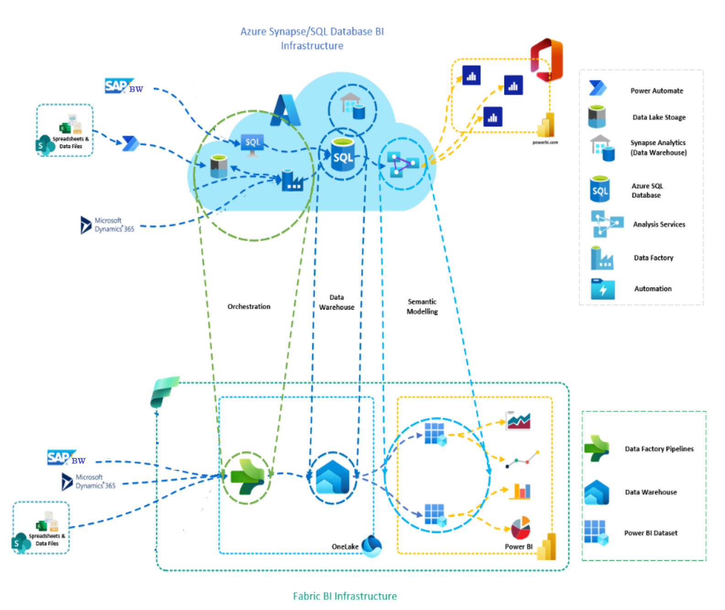
Solution
All-in-one analytics
Microsoft Fabric offers a comprehensive suite of services, including data lake, data engineering, and data integration, all in one place.
Lakehouse to store data from different sources
Pipeline and use of specific connectors for powering the lakehouse
Power BI will be able to build its own reports by direct Lake

Slide 6
Solution
Pipelines
Data acquisition from SAP
Create a workspace in Microsoft Fabric
Sign into Power BI and select the default Power BI icon at the bottom left of the screen.
Switch to the Data Factory experience.
Select Data pipeline and provide a pipeline name.
Then select Create.
Use a Copy Activity in the pipeline to load data from SAP BW hosted in AWS.
Map the data into One Lake at folder sap_data.
Record the outcome of the day’s draw.
Data acquisition from CSV
Create a workspace in Microsoft Fabric
Sign into Power BI and select the default Power BI icon at the bottom left of the screen.
Switch to the Data Factory experience.
Select Data pipeline and provide a pipeline name.
Then select Create.
Use a Copy Activity in the pipeline to load data from local folder.
Map the data into One Lake at folder csv_data.
Record the outcome of the mouth’s draw.

Slide 7
Solution
Pricing
Microsoft Fabric Capacity (Pay-as-you-go or Reservation)
Get a shared pool of capacity that powers all capabilities in Microsoft Fabric, from data modeling and data warehousing to business intelligence and AI experiences (one minute minimum).
The benefits of Fabric Capacity:
Simplified purchasing with a single pool of compute for every workload.
The ability to use the same set of Capacity Units (CUs) wherever you have the need without pre-allocating capacity.
All CUs are pooled and are not locked in an idle workload to reduce costs.
Transparent monitoring through a centralized dashboard to monitor usage and costs.
SKU | Capacity unit (CU) | Pay-as-you-go | Reservation
F 2 | 2 | €289,24/month | €171,99/month ~41% savings
F 4 | 4 | €578,47/month | €343,99/month ~41% savings
F 8 | 8 | €1.156,95/month | €687,97/month ~41% savings
Suggested sizing

Slide 8
Economics
Based on the mix of resources and our professional fee rates, what follows is our best estimation of the cost of Capgemini professional services:
Activities | Estimated Effort | Price
Project Governance | 1 MD | 5.865€
Solution Architect | 10 MD | 5.865€
Total project |  | 5.865€
 |  | 5.500€
The cost of the Microsoft Fabric subscription is excluded from the above economical proposal.
Professional fees will be invoiced to PIAM according to the following plan:
100% at the completion of the architecture deployment, payment due 60 days from the invoice date

Slide 9
Assumptions
ID | Assumption
A01 | All propaedeutics and implementation activities described in slide 5, 6 and 7 will be performed remotely with no need for Capgemini to access PIAM offices. When requested by PIAM, Capgemini will attend key meetings in PIAM offices.
A02 | Any possible travel and accommodation expenses will be invoiced in addition, upon proving documentation.
A03 | The hypothesis is made that the infrastructural configurations to allow to Microsoft Fabric connectors to acquire data from the SAP hosted on AWS in the cloudhave been accomplished.
A04 | We assume that the 3.0 or 3.1 connector is installed in the gateway machine.
A05 | We assume that the local folder has been created in which the Excel and CSV files provided by IQVIA and NewLine will be manually recorded. This folder is visible from the Azure Cloud.
A06 | Any change request (CR) to the signed off elements cited will have to be estimated and agreed by PIAM and Capgemini.

Slide 10

GET THE FUTURE YOU WANT
capgemini.com

Slide 11
About Capgemini Invent
As the digital innovation, design and transformation brand of the Capgemini Group, Capgemini Invent enables CxOs to envision and shape the future of their businesses. Located in more than 36 offices and 37 creative studios around the world, it comprises a 10,000+ strong team of strategists, data scientists, product and experience designers, brand experts and technologists who develop new digital services, products, experiences and business models for sustainable growth.
Capgemini Invent is an integral part of Capgemini, a global leader in partnering with companies to transform and manage their business by harnessing the power of technology. The Group is guided everyday by its purpose of unleashing human energy through technology for an inclusive and sustainable future. It is a responsible and diverse organization of over 360,000 team members in more than 50 countries. With its strong 55-year heritage and deep industry expertise, Capgemini is trusted by its clients to address the entire breadth of their business needs, from strategy and design to operations, fueled by the fast evolving and innovative world of cloud, data, AI, connectivity, software, digital engineering and platforms. The Group reported in 2022 global revenues of €22 billion.
Get The Future You Want | www.capgemini.com

